Slide 1

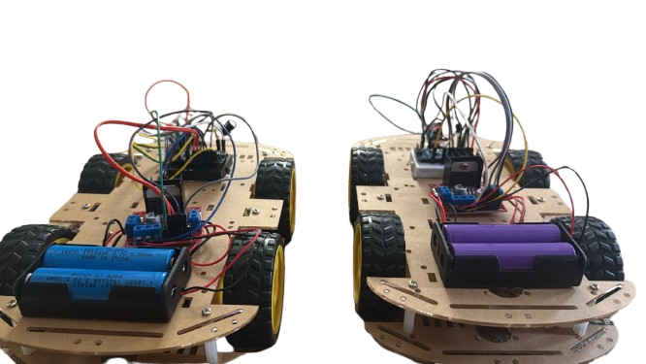
Contributors:
Assem Eldlebshany
Dylan Neoh
Erjona Dobra
Aly Moaawad
Timo Robrecht
Vanesa Metaj
Vuk Trpkovic
Youssef Soliman
DAT RACER
1

Slide 2
TABLE OF CONTENTS
01
04
Introduction
Problems & Solutions
02
05
System Architecture
Demo
03
06
Build Process
Conclusion
2

Slide 3
INTRODUCTION
What is it?
A 4-wheel drive robotic car that is controlled wirelessly and in real-time using hand gestures captured by a standard computer webcam.
Our Goal
To create an intuitive, responsive, and engaging human-machine interface for controlling a physical device, moving beyond traditional joysticks or keyboards.
Core Technologies Used:
Python: For computer vision and hand-tracking logic.
Arduino (Uno & Nano): For hardware interfacing and real-world control.
nRF24L01 Modules: For creating a low-power wireless communication link.
3

Slide 4
SYSTEM ARCHITECTURE
Computer Vision Subsystem: Processes real-time video input from webcam to determine control commands based on analysis of hand positions, orientations and finger gestures.
Arduino Uno Server: Acts as a central communication hub and processes the incoming commands that are transmitted via serial communication, then it distributes these commands to the cars wirelessly using nRF24L01 radio frequency modules.
Arduino Nano-Based Car: Translates received commands, which tells the car to perform the following actions: acceleration, decceleration and steering.
This architecture allows low-latency communcation while maintaining flexibility to support mulitple vehicles simultaneously.
4

Slide 5
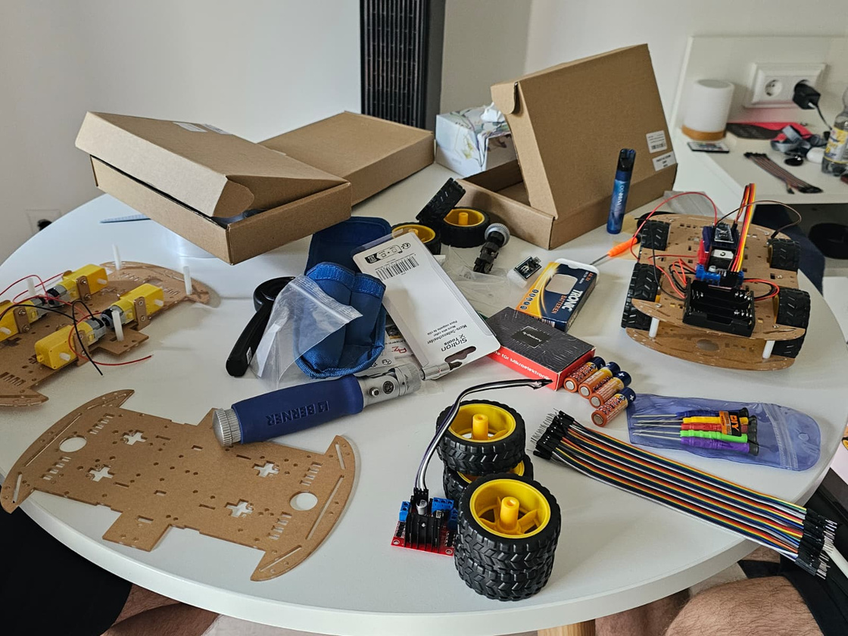
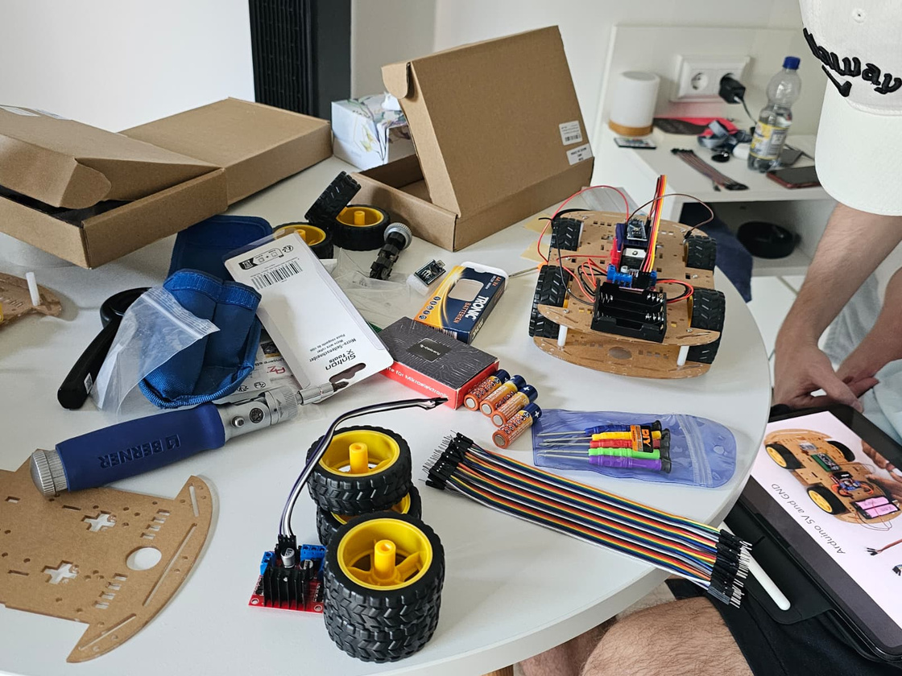
BUILD PROCESS
Assembling The Chassis
First, we attached the motors and wheels to the chassis. With the frame built, we secured the Arduino and motor driver board.
5

Slide 6
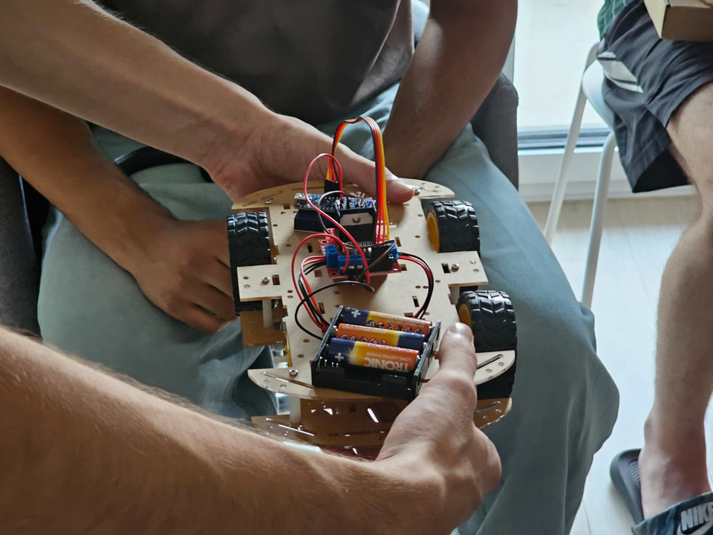
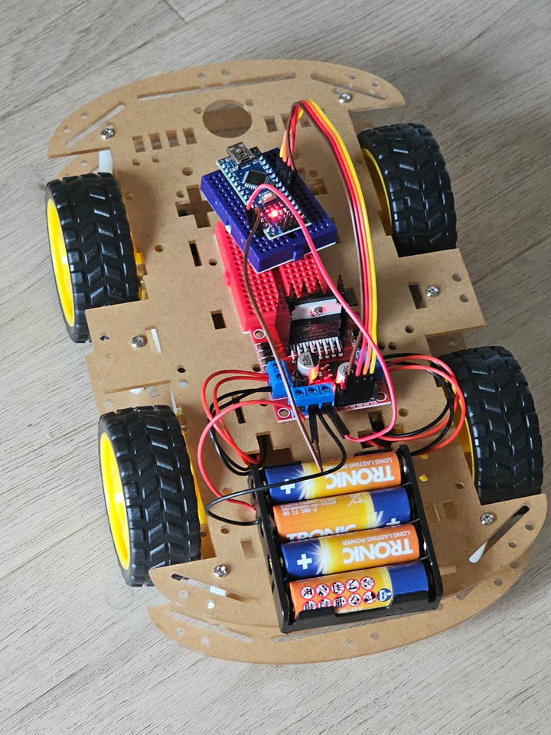
BUILD PROCESS
Initial Wiring
We assembled the chassis with standard AA batteries and we loaded a simple test code directly onto Arduino to see if the car would move. It didn’t work, so we confirmed that there was a hardware problem.
6

Slide 7
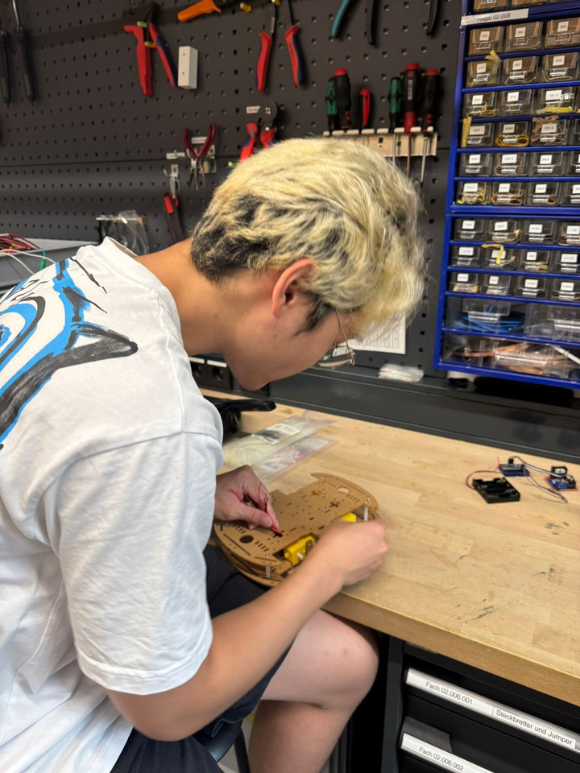
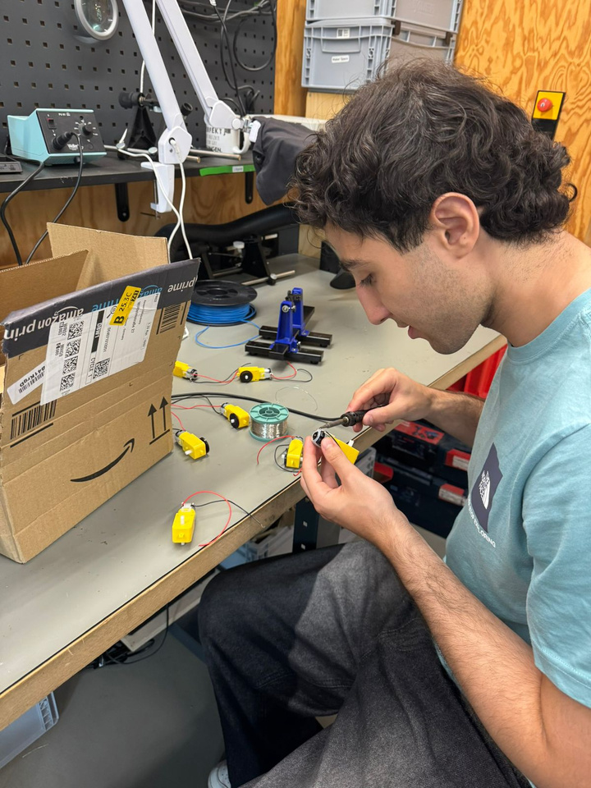
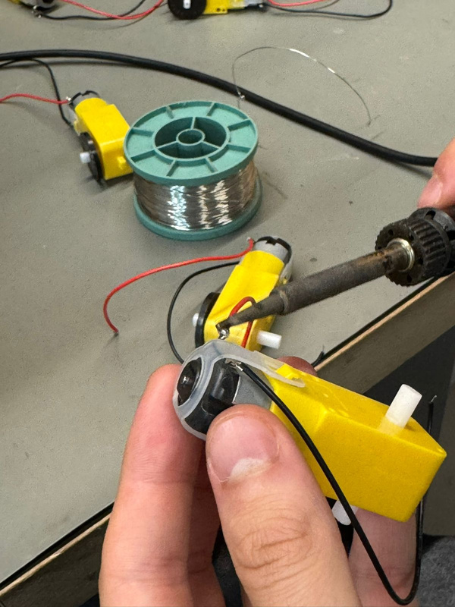
BUILD PROCESS
Welding
Our first fix was to create reliable electrical connections by soldering the wires directly to the motor terminals. The motors now received commands consistently.
7

Slide 8
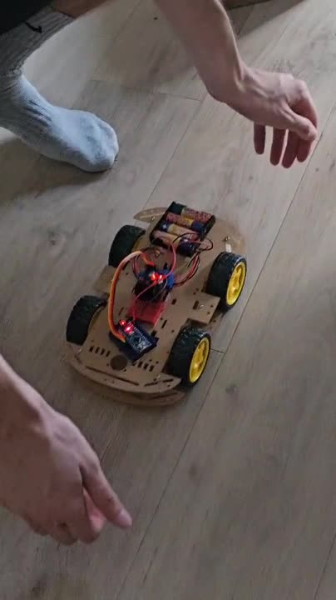
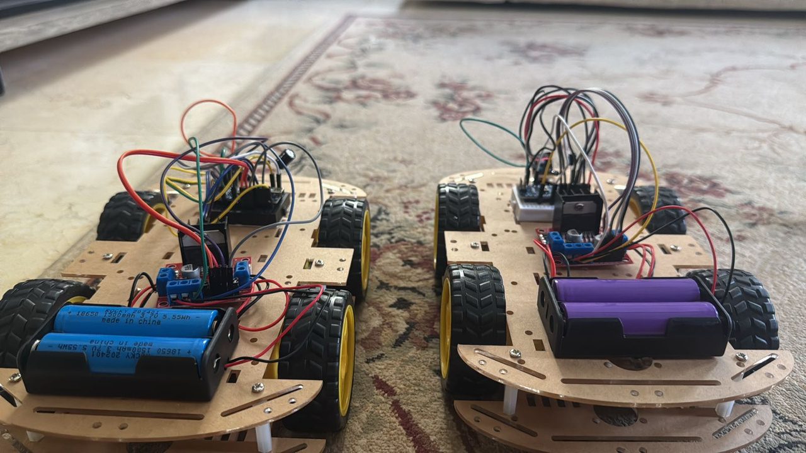
BUILD PROCESS
Power Supply
After soldering, we still encountered problems to do with the motors and realized that the AA batteries couldn't provide enough current to drive four motors, so we upgraded to lithium batteries, which provided the necessary power for the car to move.
8

Slide 9
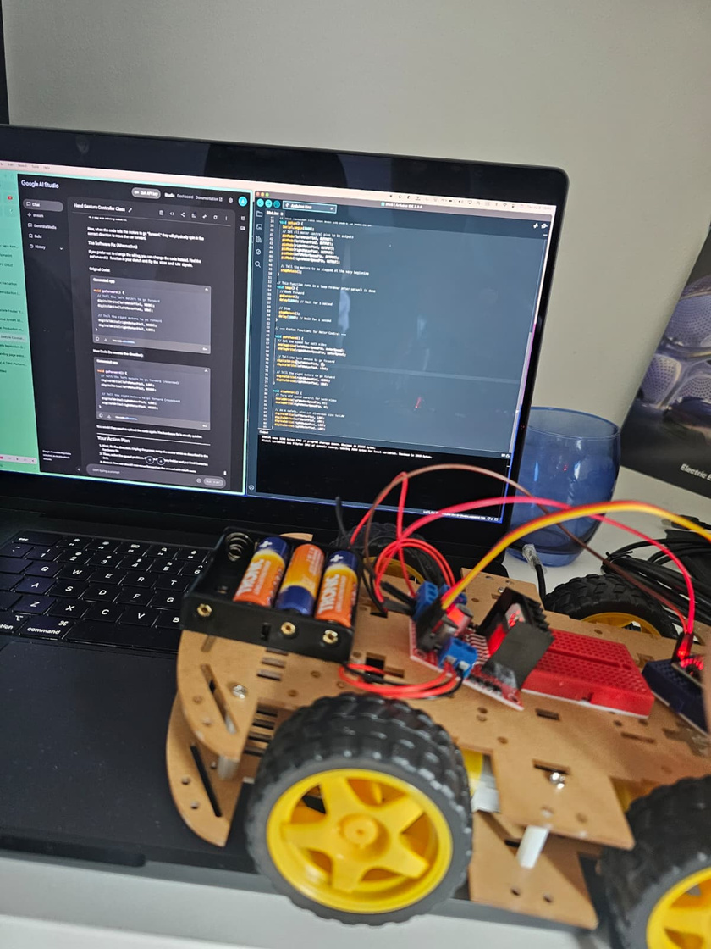
BUILD PROCESS
Testing and Debugging
The final phase was to connect the car with the code and to make it work correctly.
We fixed a lot of performance issues, like making the car drive as intended and smoothing out movement by adjusting the logic.
9

Slide 10
THE SIGNAL PATH
This diagram shows the path of a command, from the hand gesture captured on the Mac all the way to the car's movement.
1. Mac
2. Arduino Uno
3. Arduino Nano
4. L298N Motor Driver
5. Motors & Car
10

Slide 11
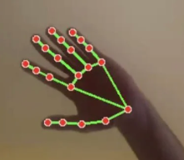
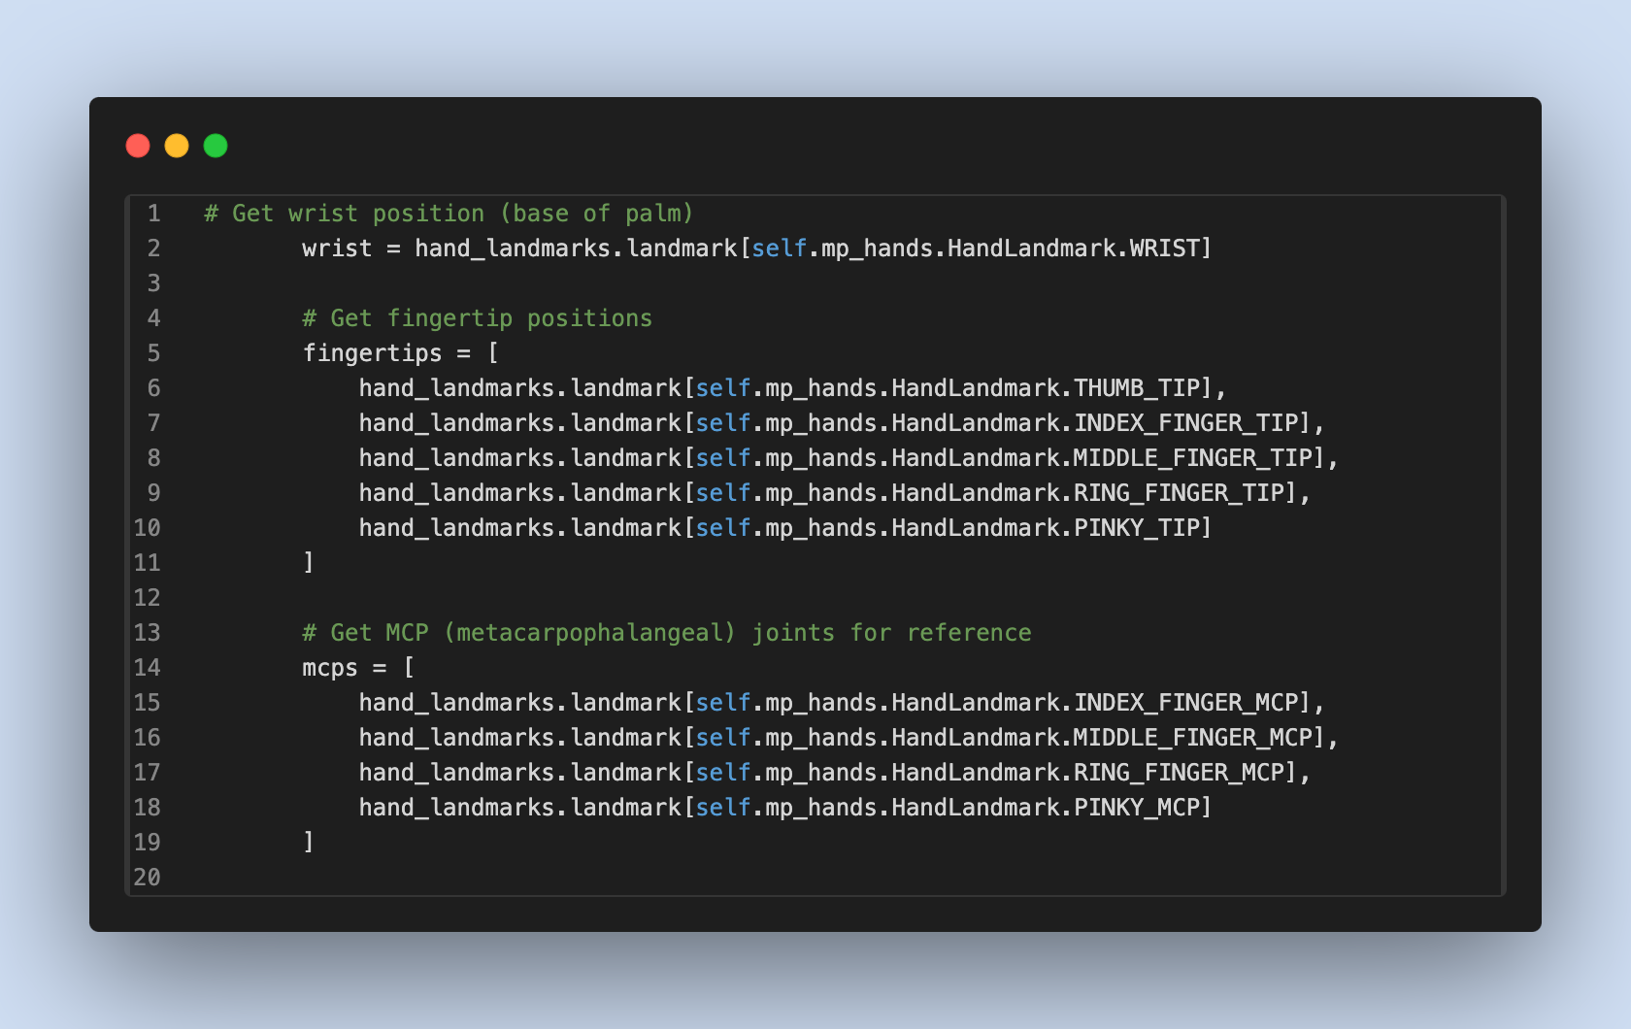
STEP 1: HAND GESTURE TO DATA
Action: Calculates openness of hand to determine the speed of car
Hand Identification in MediaPipe
MediaPipe Hands detects hands in real time using a two-step pipeline:
Palm Detection – A lightweight model first locates the palm within the image. This is faster and more reliable than detecting the entire hand directly.
Hand Landmark Model – Once the palm is found, a second model predicts twenty-one 3D landmarks (x, y, z) on the hand, including the wrist, fingertips, and knuckles.
In the code an array of the landmarks of fingertips and MCP (knuckles) is created, as well as the landmark of the wrist is initialized.
11

Slide 12
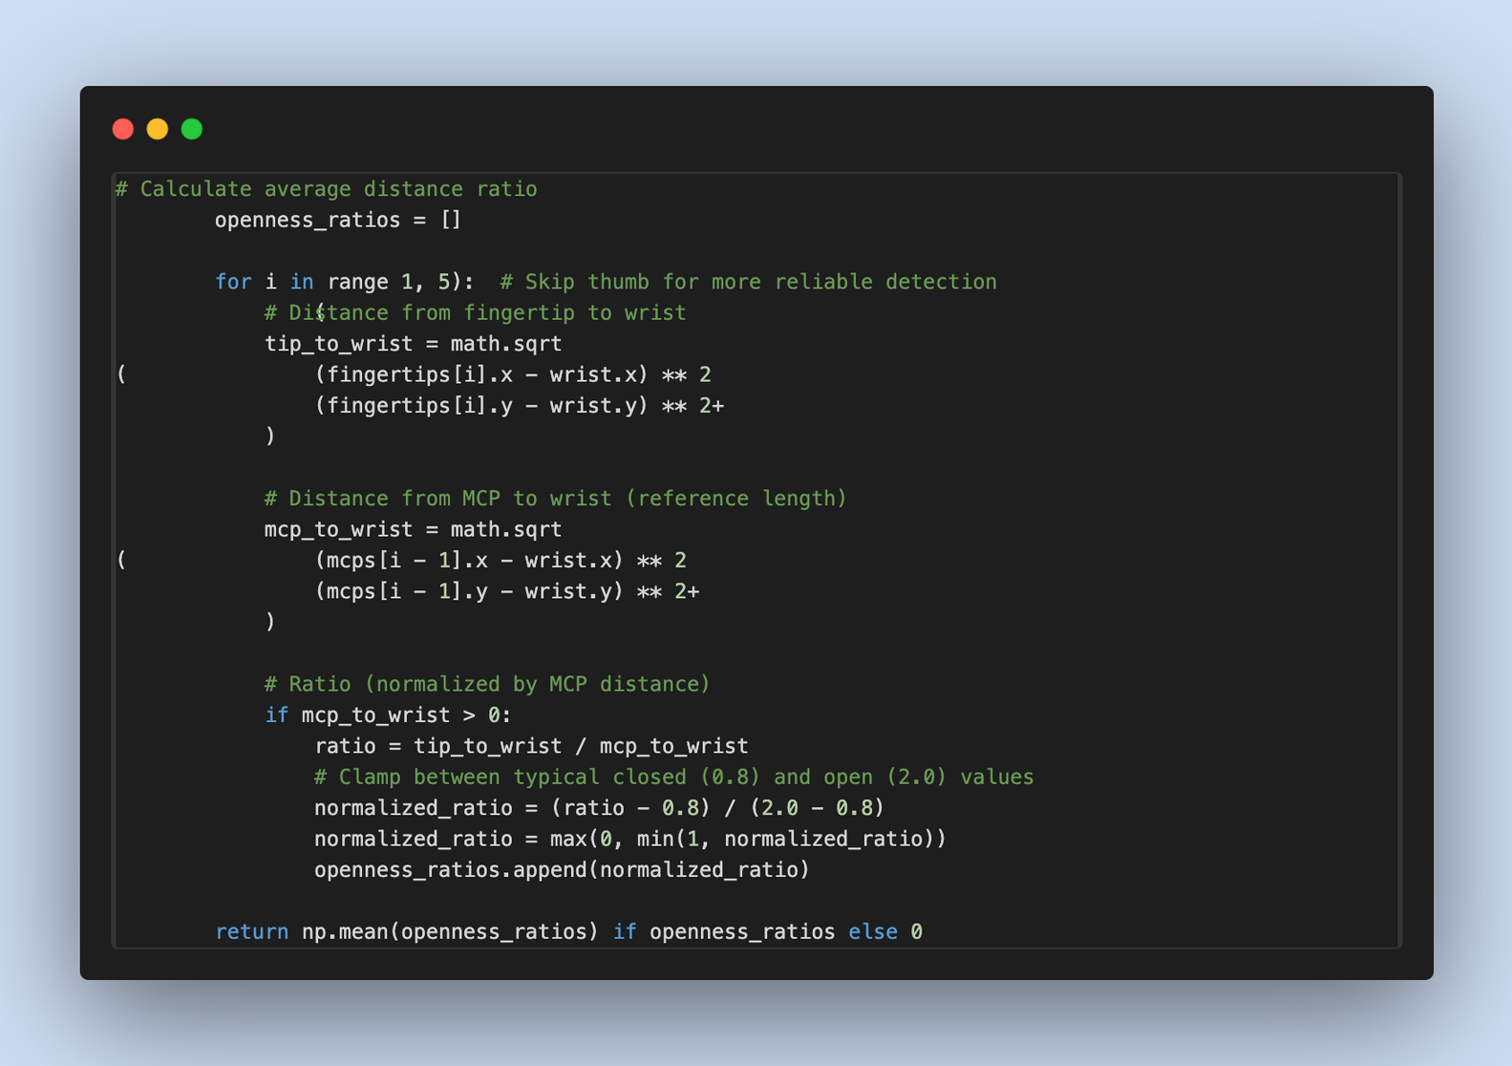
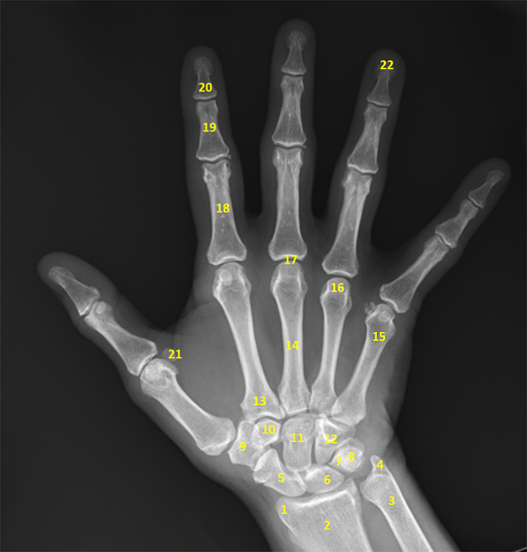
STEP 1: HAND GESTURE TO DATA
Action: Calculates openness of hand to determine the speed of car
This code measures hand openness by comparing fingertip-to-wrist distance vs. knuckle-to-wrist distance, normalizes it to a scale from 0 to 1, with 0 being the hands closed and 1 being the hands fully opened , and returns the averages across 4 fingers.
12

Slide 13
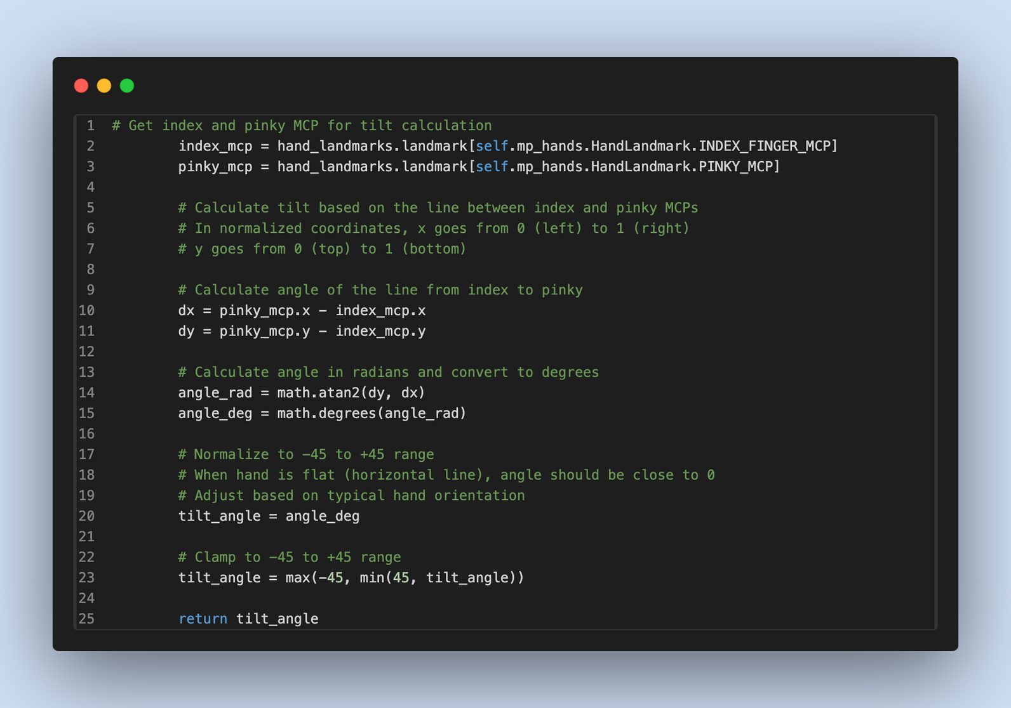
STEP 1: HAND GESTURE TO DATA
Action: Calculates tilt of hand to be used as the steering of car.
Get the landmarks of the knuckles of index and ring finger.
Find the horizontal difference (dx) and the vertical difference (dy)
Calculate angle between line between index and ring to horizontal axis using the math.atan2(dy,dx) function
normalize it between -45° (left) and +45° (right)
13

Slide 14
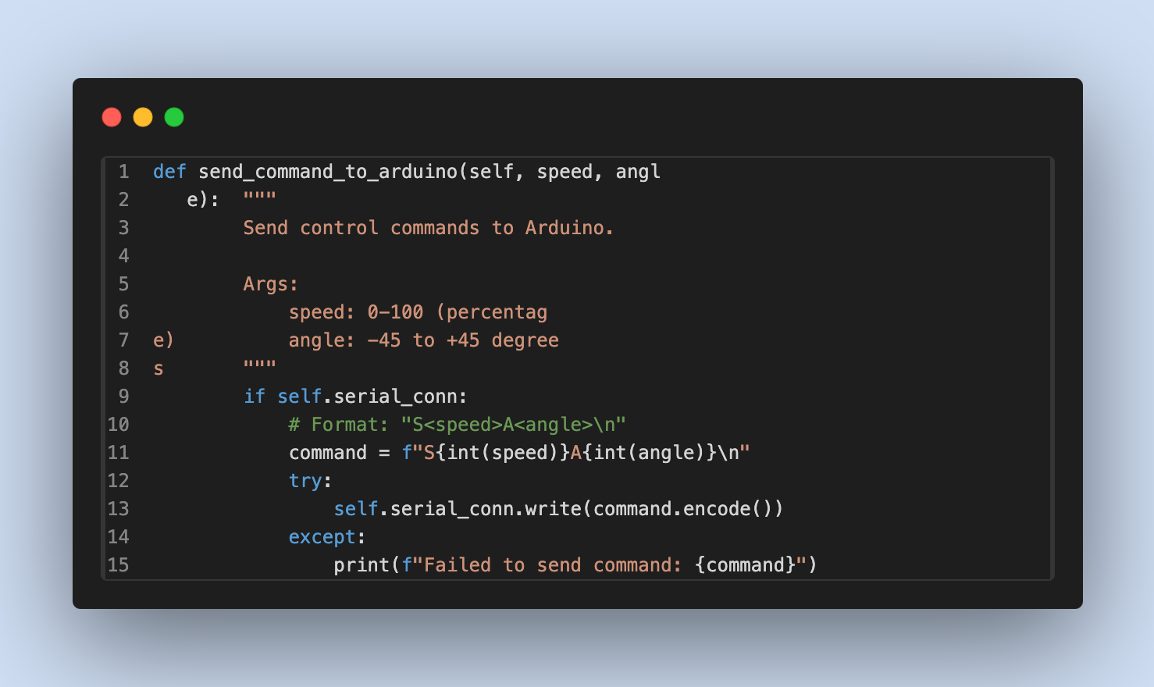
STEP 1: HAND GESTURE TO DATA
Action: Sends information needed for car based on calculation.
Function that sends the commands to the car
14

Slide 15
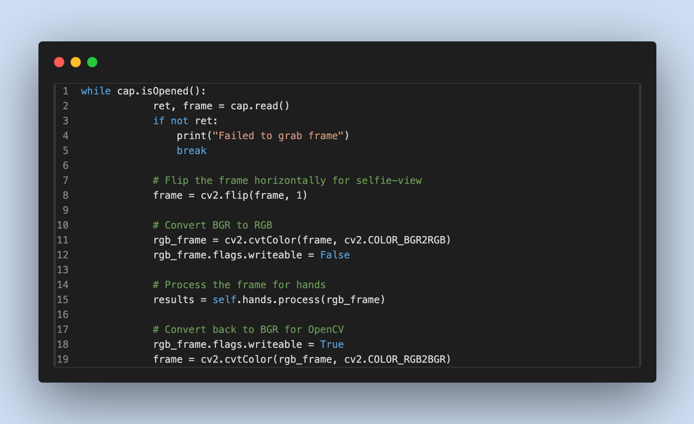
STEP 1: HAND GESTURE TO DATA
Action: Sends information needed for car based on calculation.
Code for Hand detection, identifies the landmarks
15

Slide 16
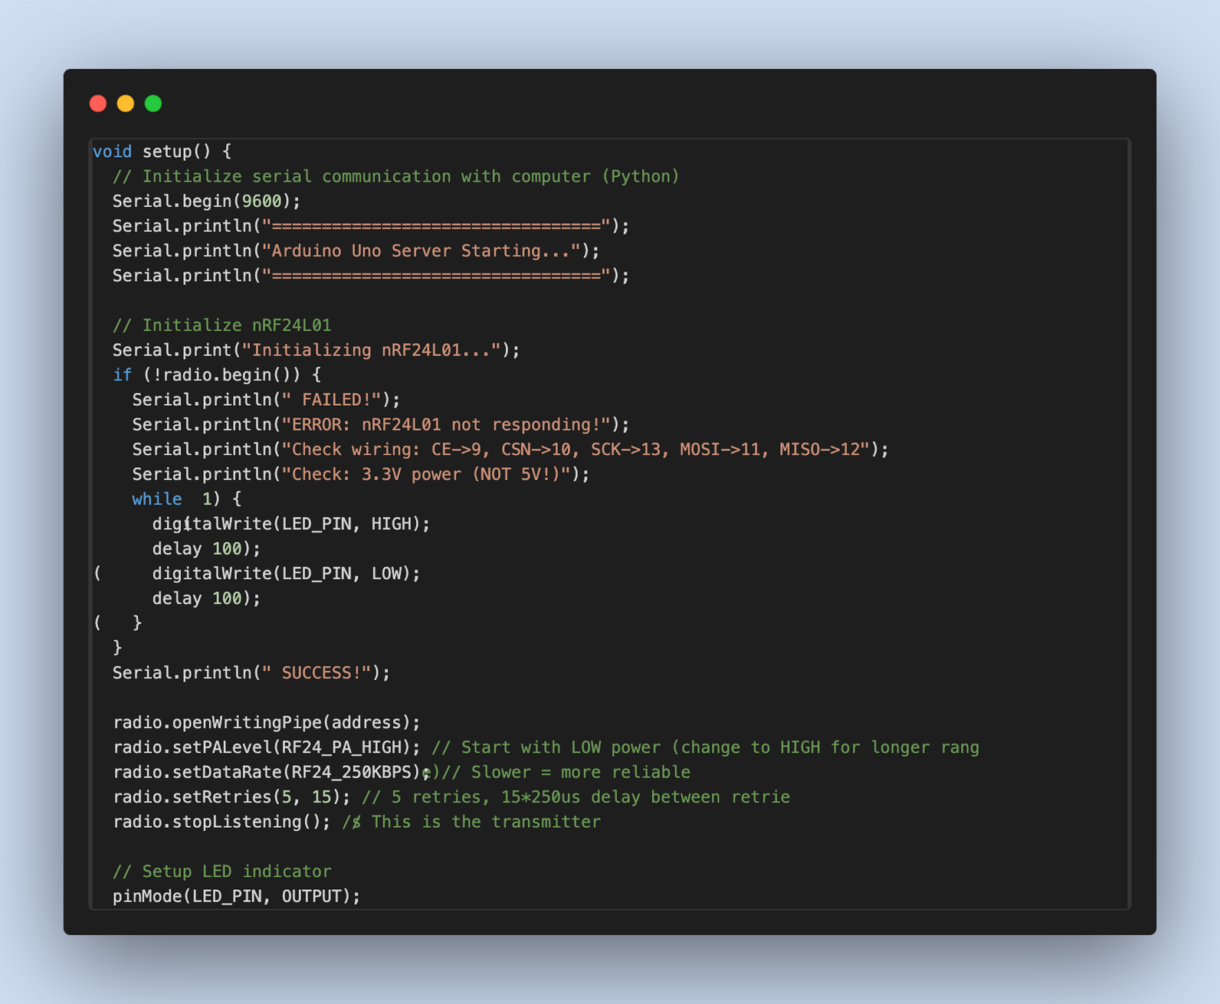
STEP 2: ARDUINO SERVER IMPLEMENTATION
1. Uno Setup & Initialization
Arduino Uno establishes serial communication with the Python controller.
Wireless communication with cars is set up via the nRF24L01 module, before proceeding to prevent silent failures.
Initialization checks ensure the radio module is working before proceeding.
16

Slide 17
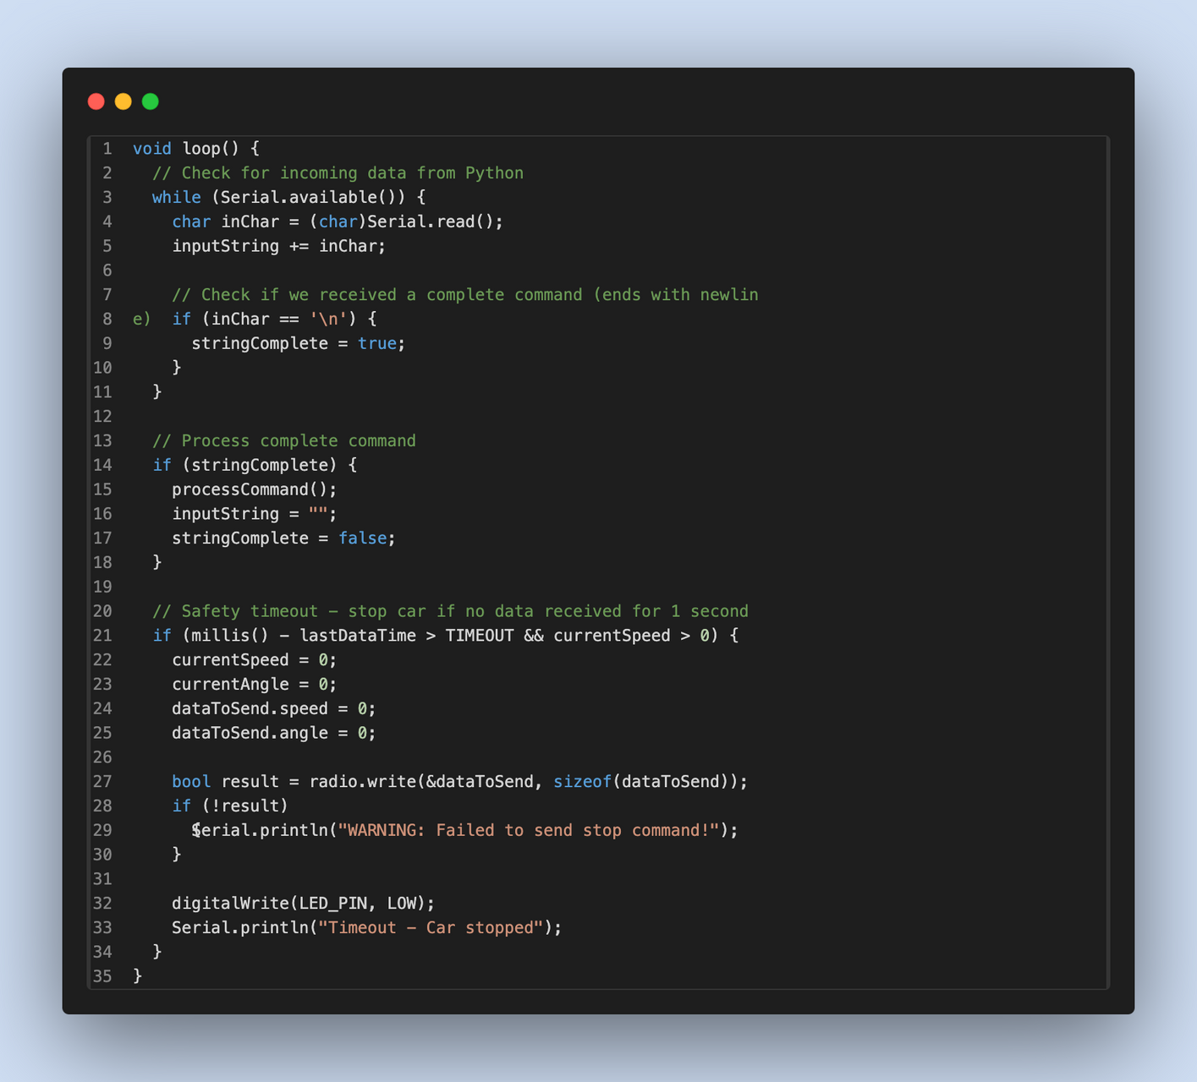
STEP 2: ARDUINO SERVER IMPLEMENTATION
2. Command Processing System
Serial commands are received as strings from the computer.
A parsing system accumulates data until a complete command is received.
This prevents partial or corrupted commands from being executed.
17

Slide 18
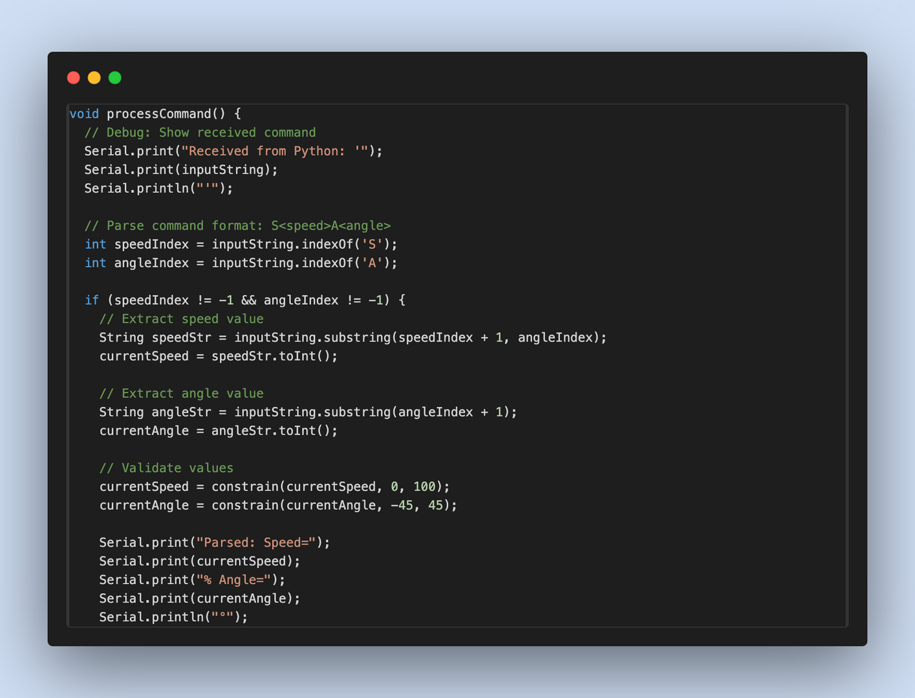
STEP 2: ARDUINO SERVER IMPLEMENTATION
3. Multi-Vehicle Command Distribution
The parser extracts vehicle-specific speed and angle values.
Commands are validated and constrained to safe ranges.
18

Slide 19
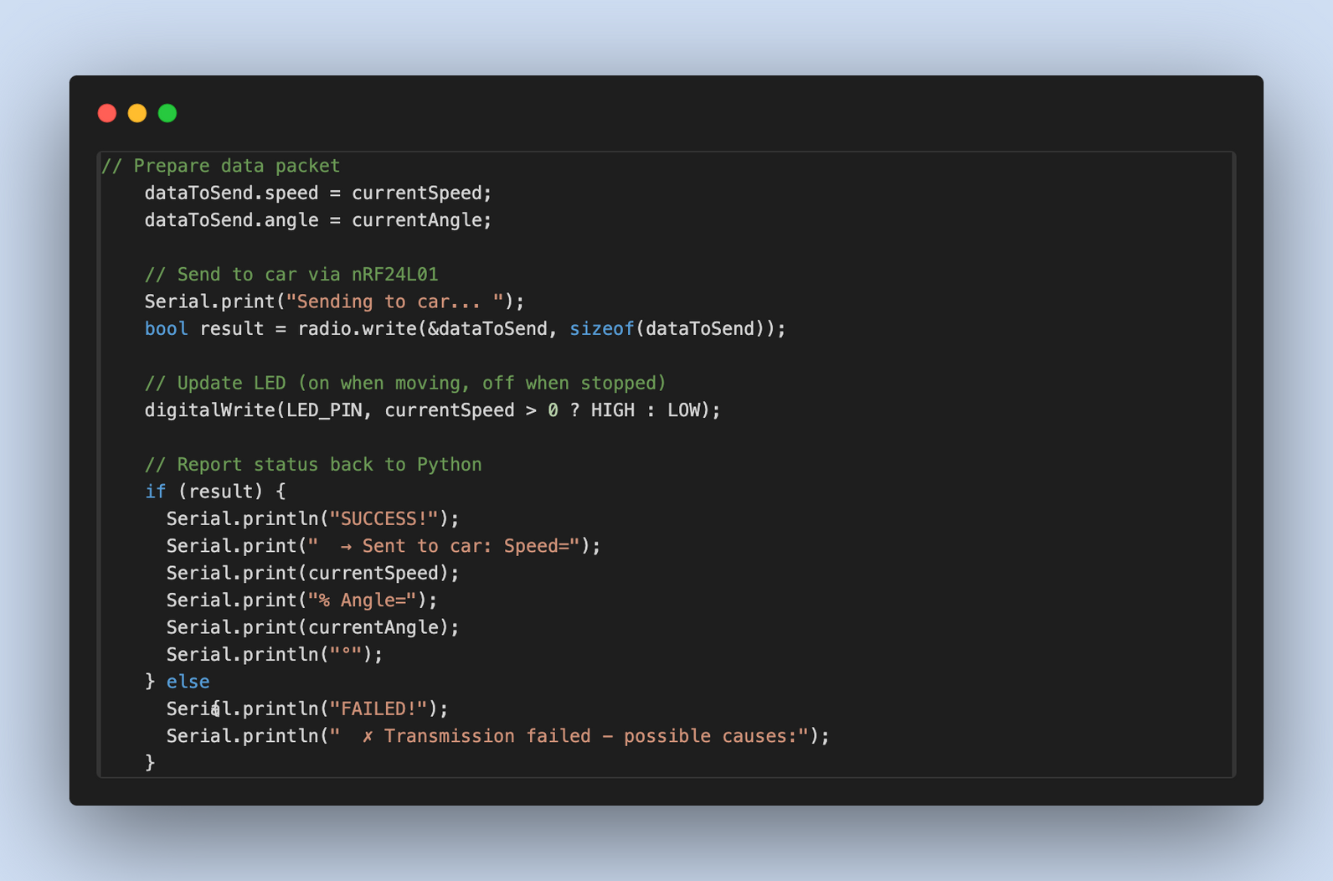
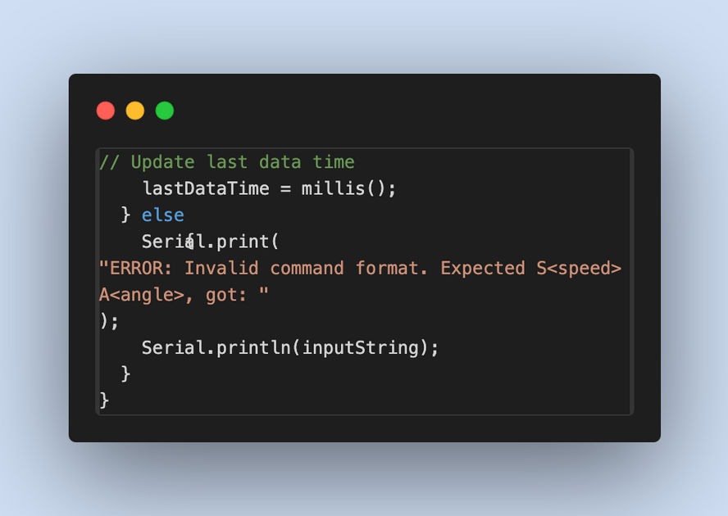
STEP 2: ARDUINO SERVER IMPLEMENTATION
4. Wireless Transmission Protocol
Data is sent in a structured packet format for consistent interpretation.
Reliability settings (high power, low data rate, retries) ensure robust communication.
Each car has a unique wireless address for targeted control.
5. Safety Timeout System
A watchdog monitors the timing of received commands.
If no new commands arrive within a set period, both cars are automatically stopped.
Prevents runaway behavior in case of communication failure.
19

Slide 20
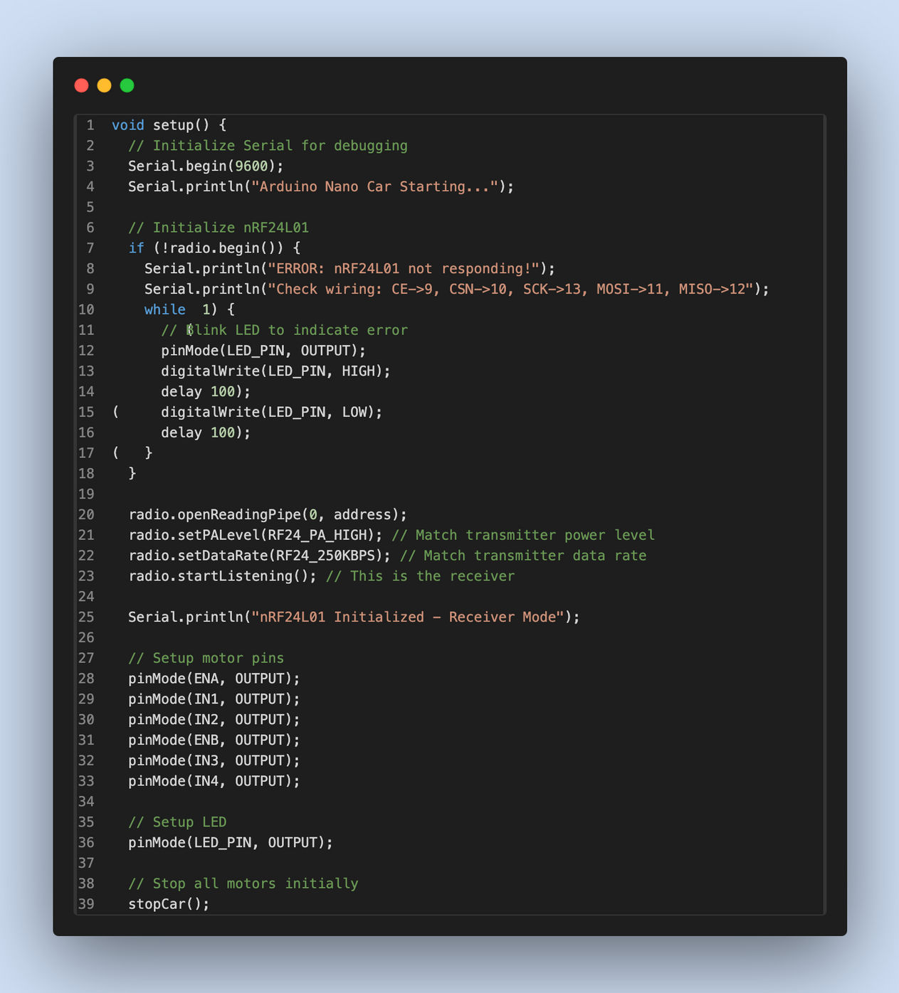
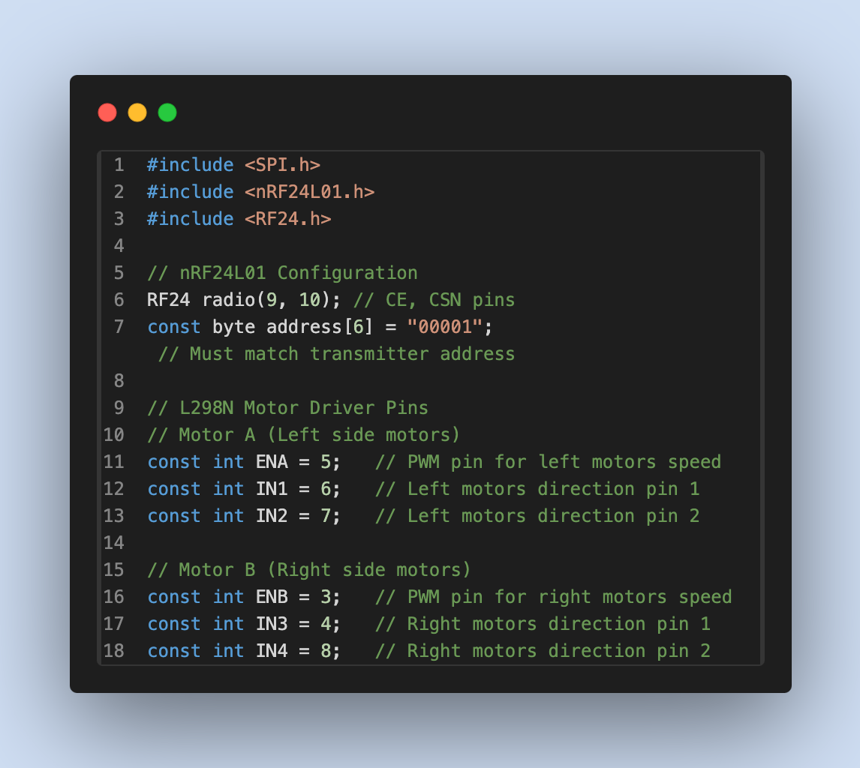
STEP 3: CAR RECEIVER IMPLEMENTATION
1. Nano Receiver Setup
Configures wireless communication using the nRF24L01 module.
Initializes motor driver pins and ensures a safe startup by stopping the car initially.
Settings mirror the server for full compatibility.
20

Slide 21
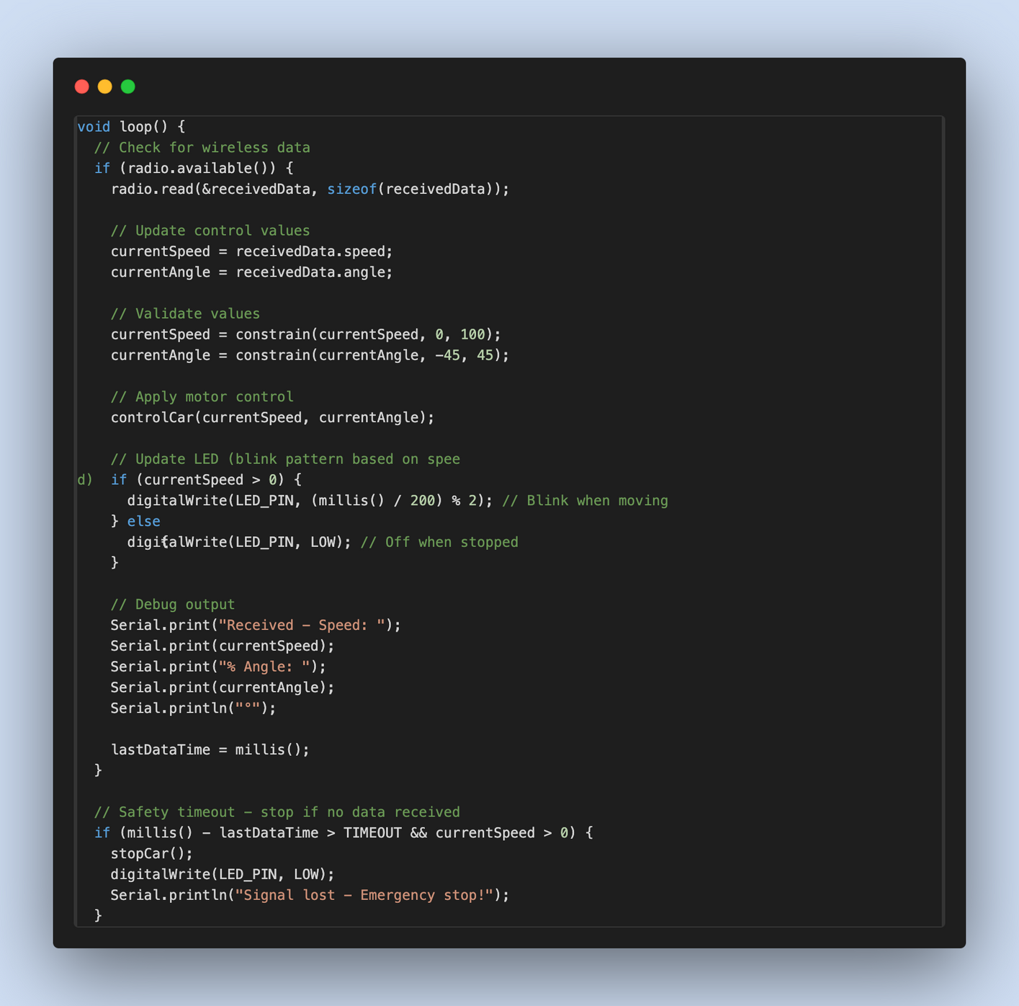
STEP 3: CAR RECEIVER IMPLEMENTATION
2. Wireless Command Reception
Continuously listens for incoming commands from the Arduino Uno server.
Extracts speed and angle values, validating them to prevent corrupted or unsafe inputs.
Provides debug feedback for system diagnostics.
21

Slide 22
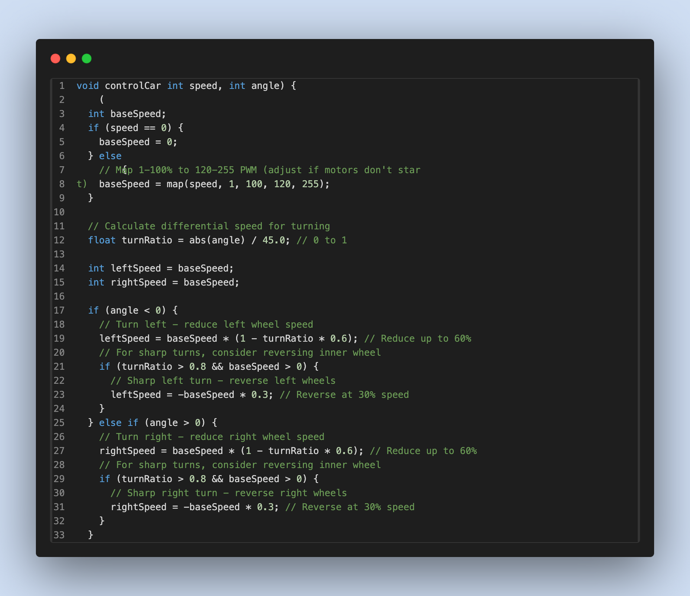
STEP 3: CAR RECEIVER IMPLEMENTATION
3. Advanced Motor Control Algorithm
Implements speed mapping for smooth acceleration and precise low-speed control.
Uses differential steering: reduces inner wheel speed during turns for natural vehicle motion.
Maintains high power capability at higher speeds.
22

Slide 23
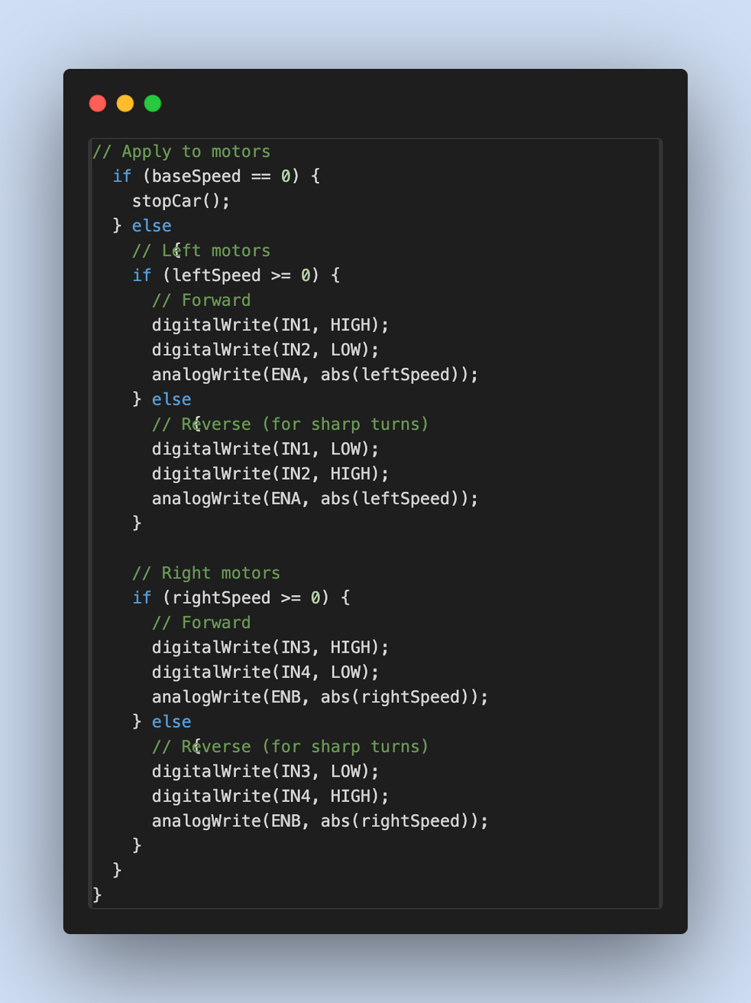
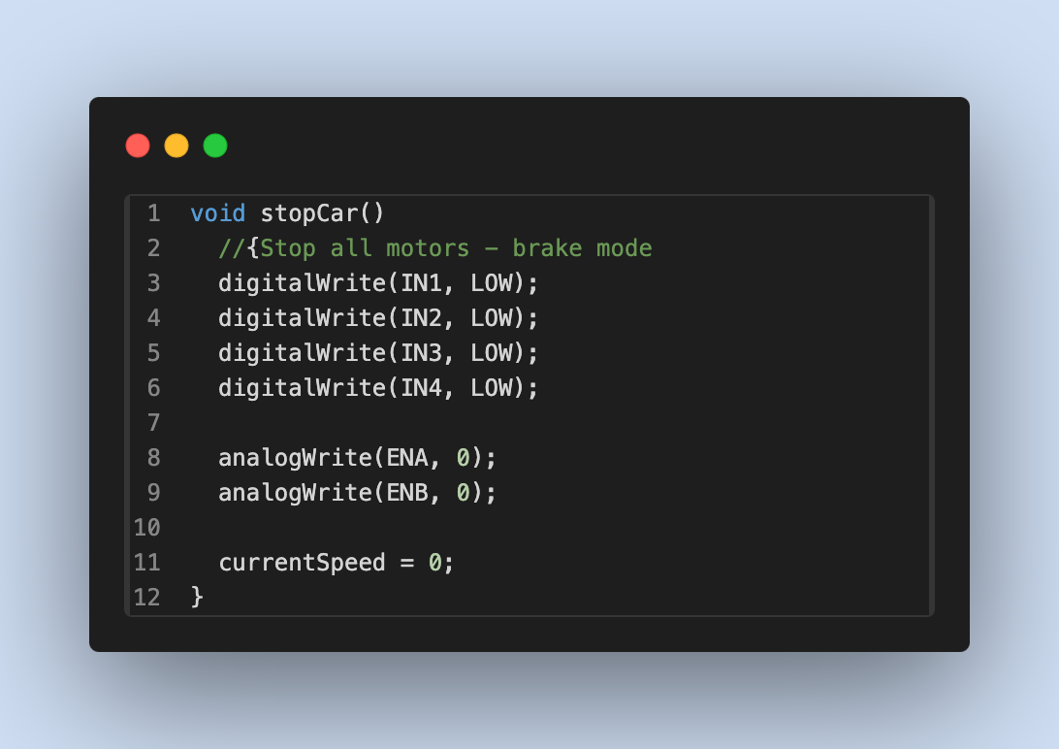
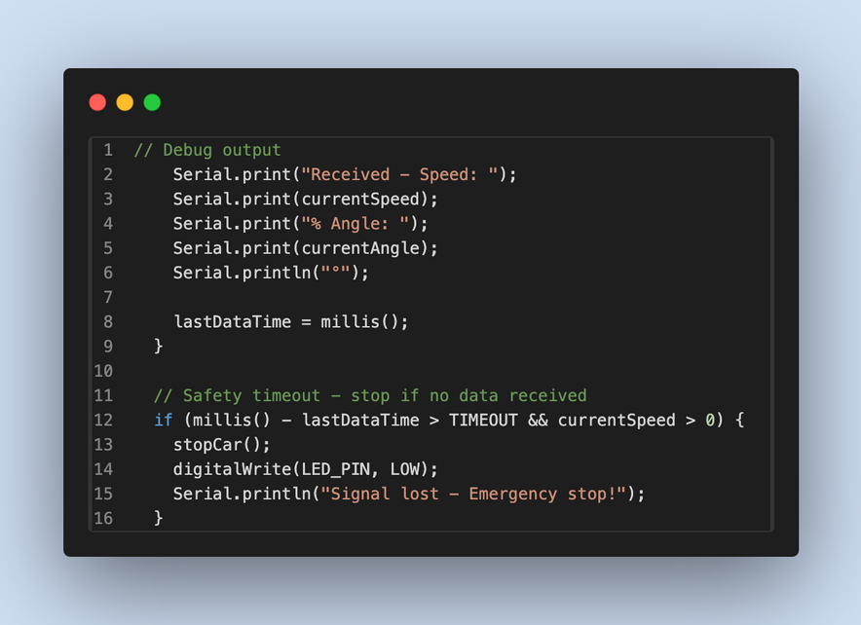
STEP 3: CAR RECEIVER IMPLEMENTATION
4. Motor Driver Interface
Translates processed commands into PWM and direction signals for the motors.
Enables advanced maneuvers such as pivot turns when needed.
5. Vehicle Safety Systems
Monitors timing of received commands.
If no commands are received within a timeout period, the vehicle automatically stops.
Prevents runaway behavior in case of communication failure.
23

Slide 24
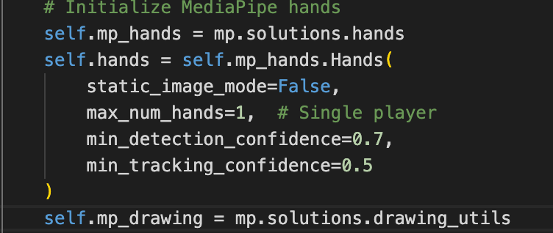
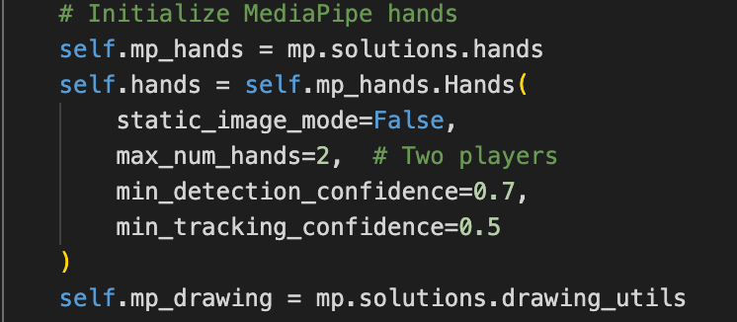
STEP 4: MULTIPLAYER IMPLEMENTATION
Changes made in computer vision subsystem
*max_num_hands value reflects the number of players
24

Slide 25
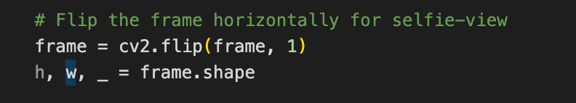
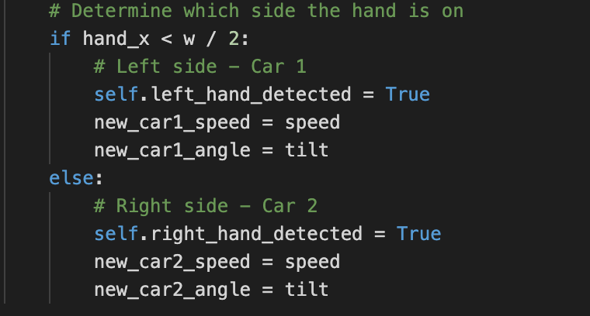
STEP 4: MULTIPLAYER IMPLEMENTATION
Changes made in computer vision subsystem
In the case of two players, screen is split into halfs and hand of player 1 will be detected on one half and player 2's hand will be on the other half.
25

Slide 26
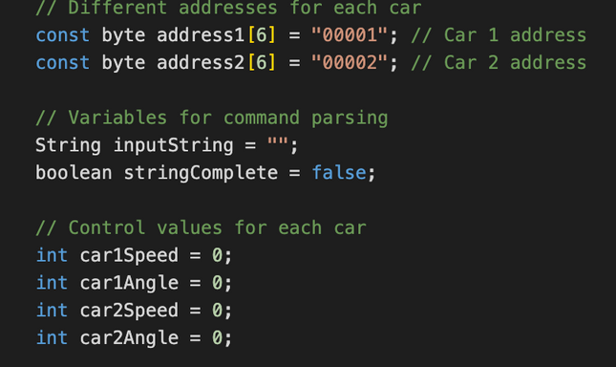
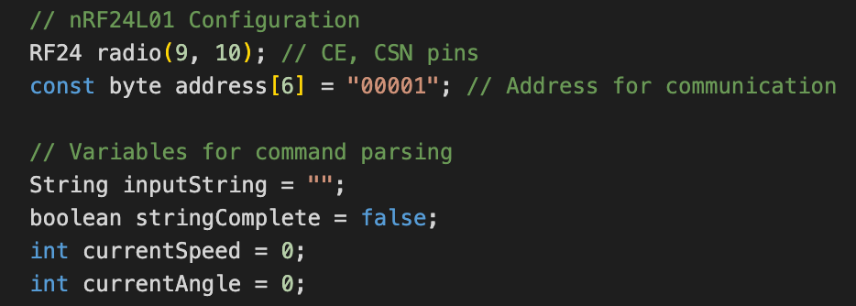
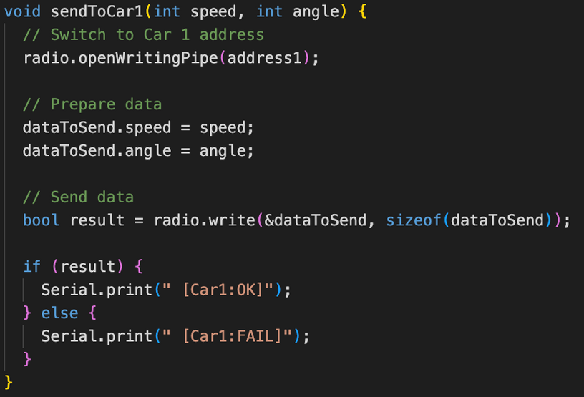
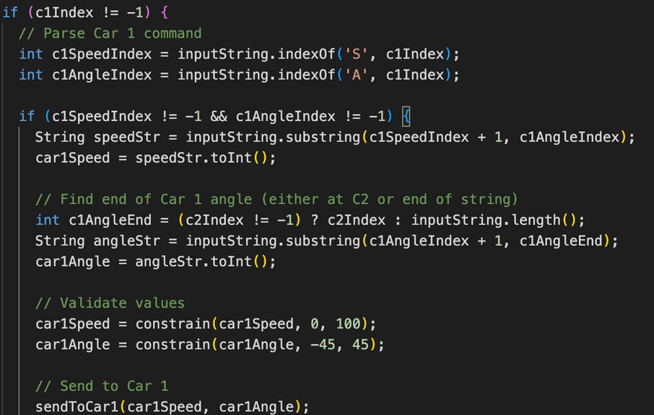
STEP 4: MULTIPLAYER IMPLEMENTATION
Changes made in Arduino Server
Initialize two different addresses and two additional control values for second car
Creation of individual functions for sending data packets of respective cars
26

Slide 27
PROBLEMS WE FACED & HOW WE SOLVED THEM
Costly Components
→ purchased more price-efficient alternatives from overseas
Inconsistent Power Delivery
→ switched from AA batteries to lithium-ion batteries
Unreliable Wiring
→ welded connections at MakerSpace
Communication Errors
→ systematic debugging to isolate key errors
Unstable Control Handling
→ implemented timeout mechanisms and low-latency communication
27

Slide 28
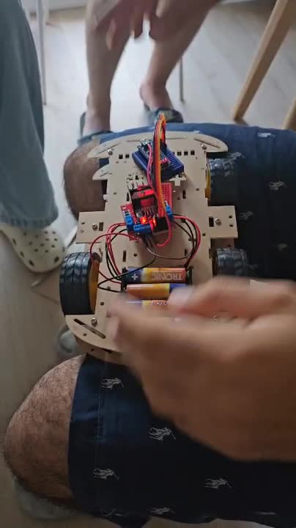
PROBLEMS WE FACED & HOW WE SOLVED THEM
28

Slide 29
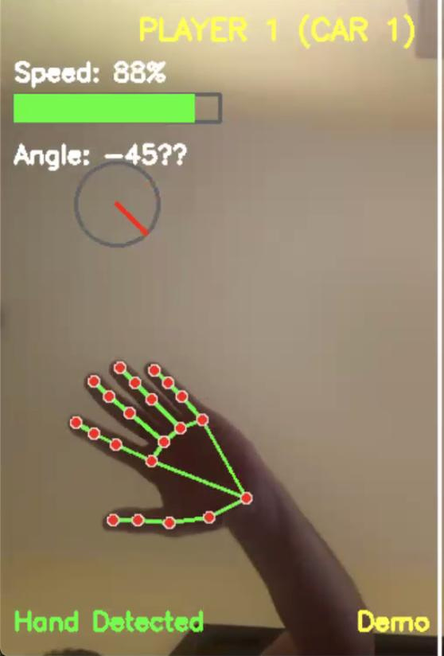
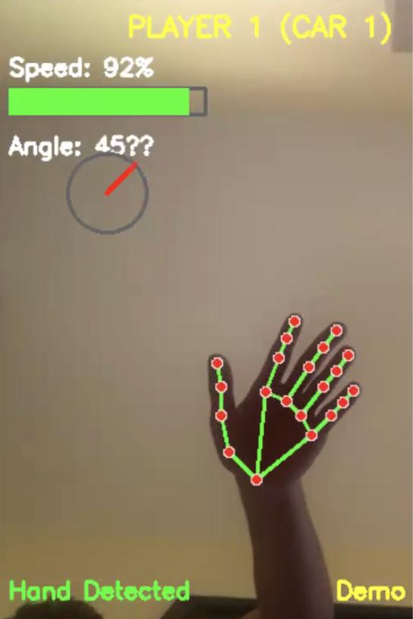
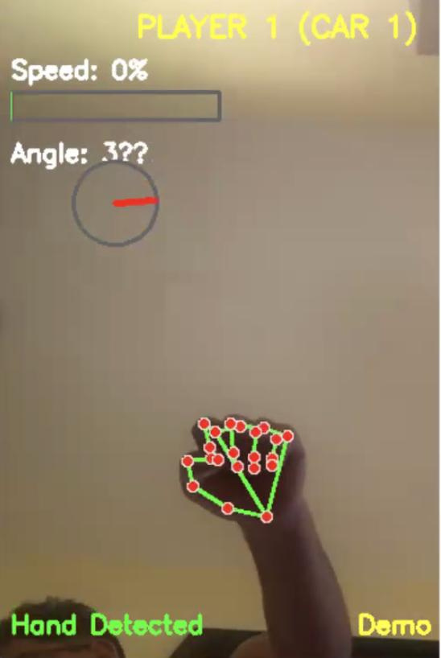
PROBLEMS WE FACED & HOW WE SOLVED THEM
29

Slide 30
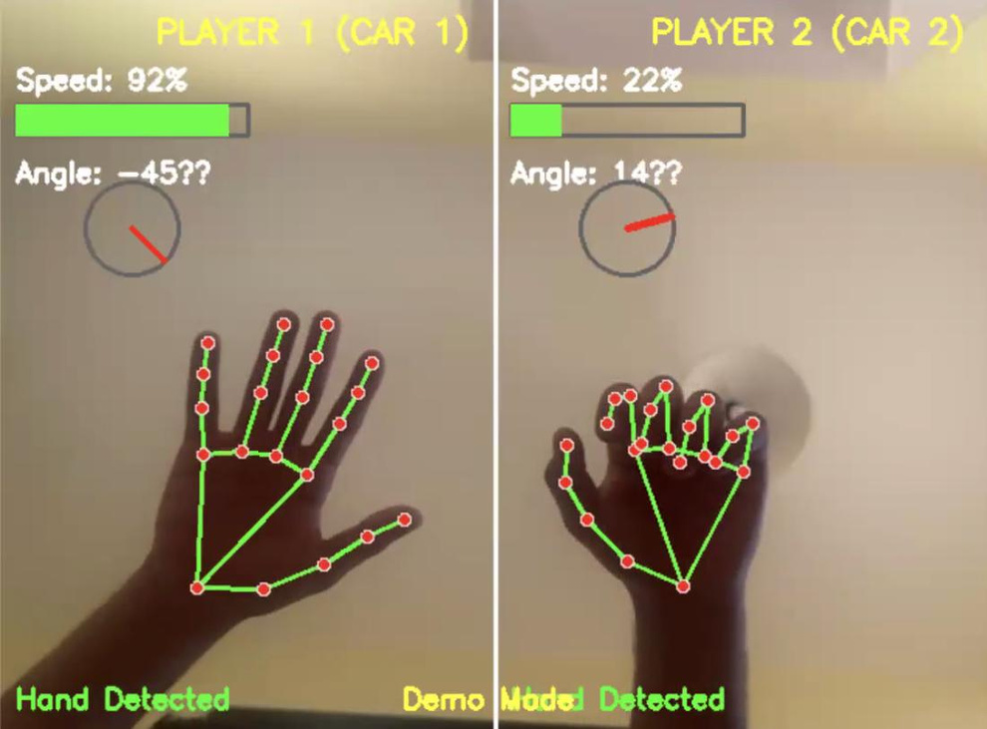
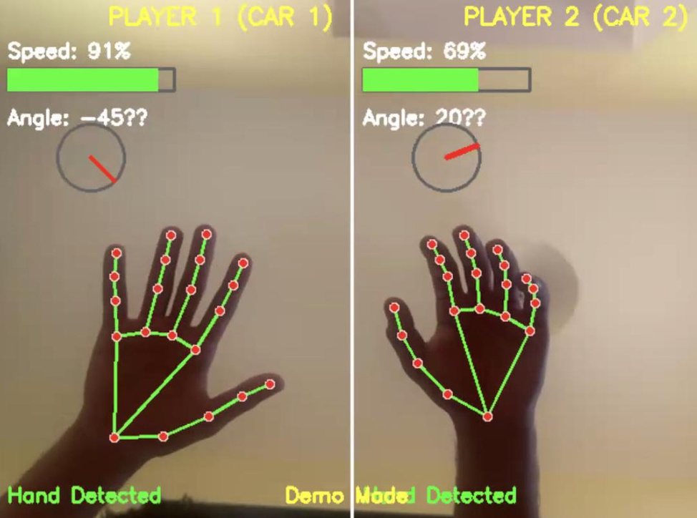
PROBLEMS WE FACED & HOW WE SOLVED THEM
30

Slide 31
LIVE DEMO
31

Slide 32
Please reference video in the Github repo
Due to size constraints while uploading

Slide 33
CONCLUSION & FUTURE ENHANCEMENTS
Key Achievements:
Seamless Integration: We effectively merged Python-based computer vision with low-level Arduino hardware control.
Reliable Communication: We engineered a robust communication system with safety features like timeouts and transmission retries.
Intuitive Control: The final system is highly responsive and provides an engaging user experience.
Future Improvements:
Install FPV Cameras: provides the player with first-person POV and adds vehicle safety measures
Expand Gesture Vocabulary: Add more gestures for actions like going in reverse, spinning in place, or activating lights.
Incorporate Sensor Feedback: Add sensors to the car (like ultrasonic or infrared) to detect obstacles and prevent collisions.
33

Slide 34


